Slide 1
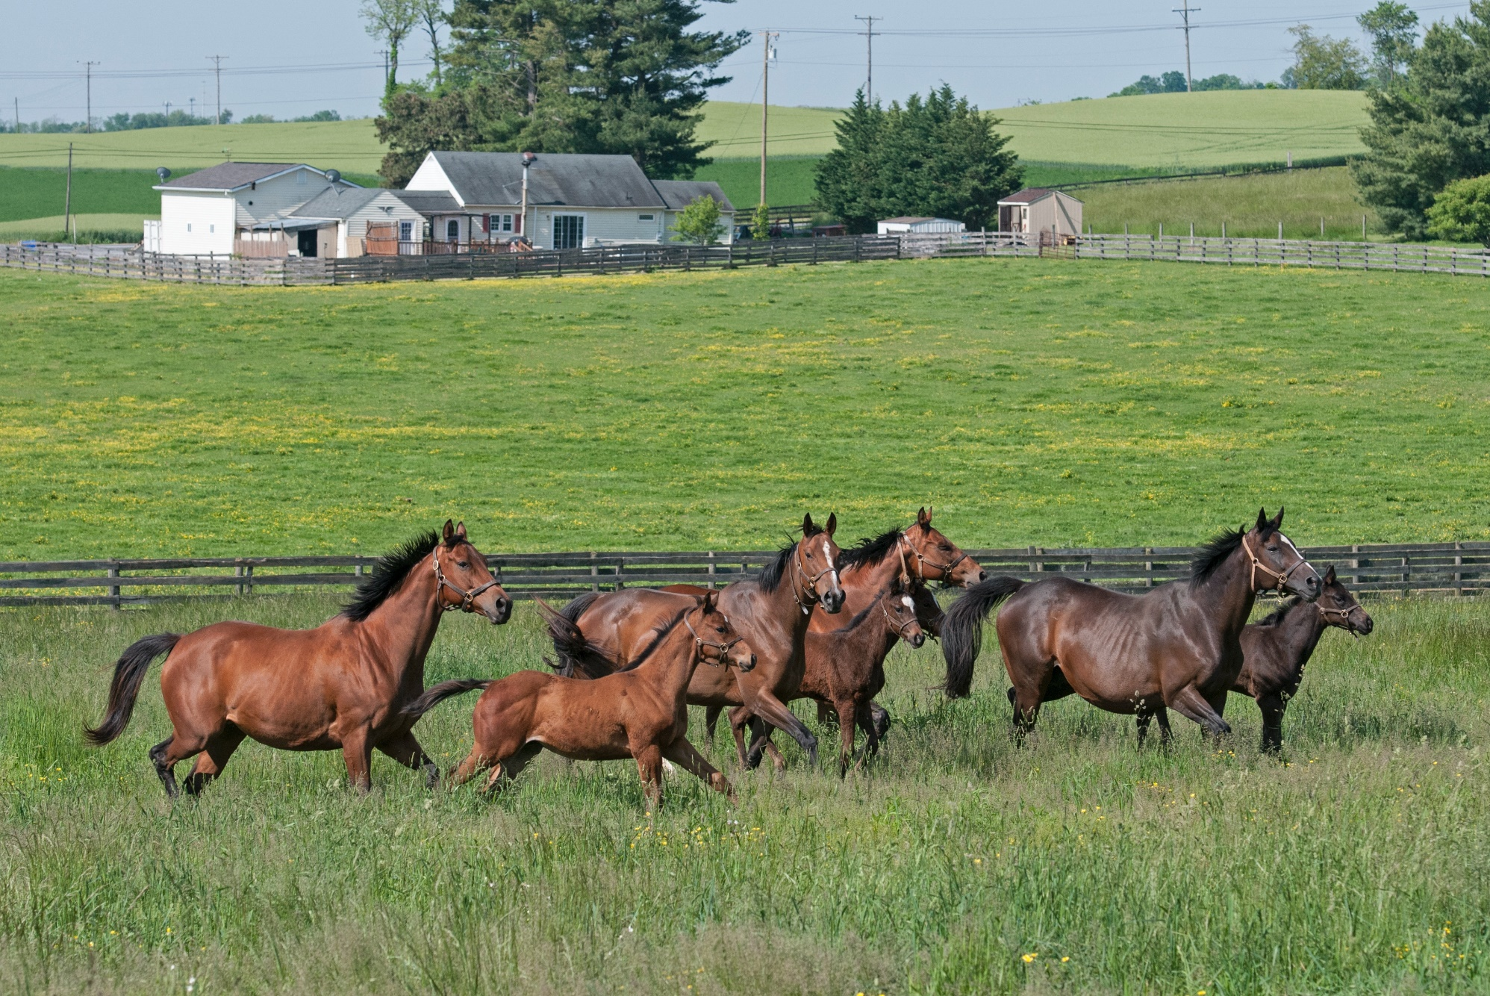
Maryland’s Thoroughbred Breeding Industry:
Steps to Survive and Thrive

Slide 2
WHAT IS THE
HORSE BREEDING INDUSTRY?
The Horse Breeding Industry is all aspects of agriculture involved in maintaining horses of breeding age and raising their offspring.
It encompasses the horses, their owners and caretakers, as well as the associated farms and many ancillary service providers.

Slide 3
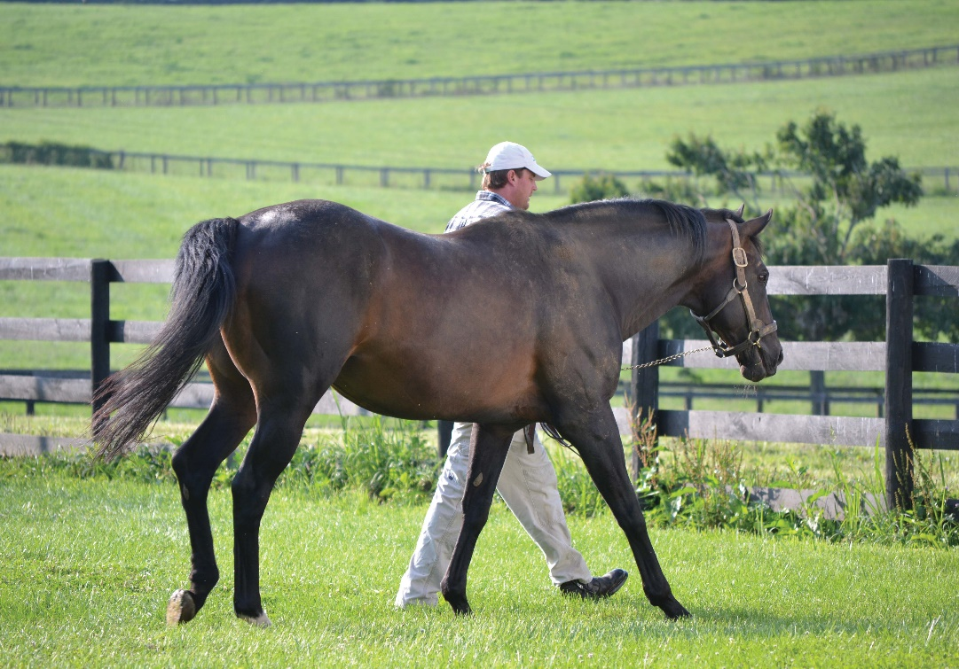
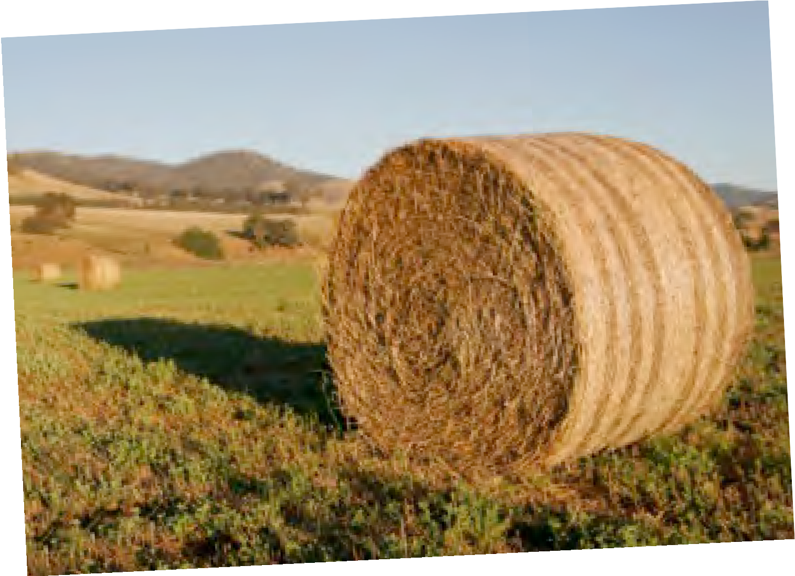
MARYLAND EQUINE
INDUSTRY SIGNIFICANCE
28,000-plus people involved
$1 billion spent annually by industry participants
705,000 total acres
Economic impact: $2.1billion
Economic impact of racing and breeding sector: $572 million
Tax revenue: $80 million

Slide 4
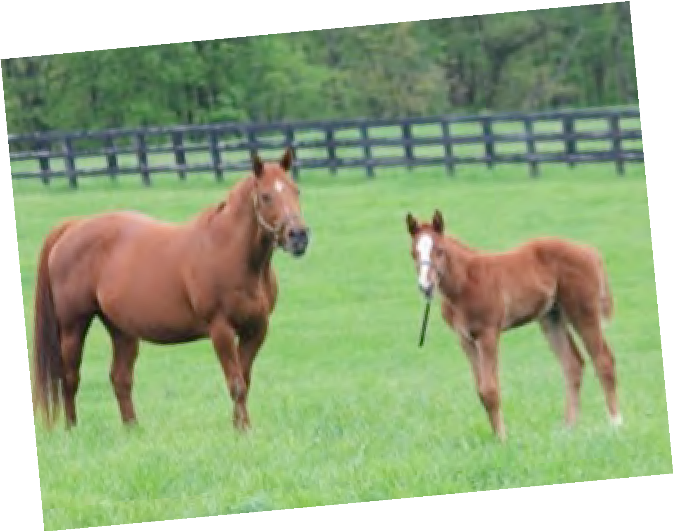
MARYLAND HORSE BREEDERS
ASSOCIATION: A NATIONAL LEADER
First state Thoroughbred breeders association (1929)
First state Thoroughbred breeders incentive program (Maryland Fund, 1962)
First one-day state-sired event day (Maryland Million, 1986)

Slide 5
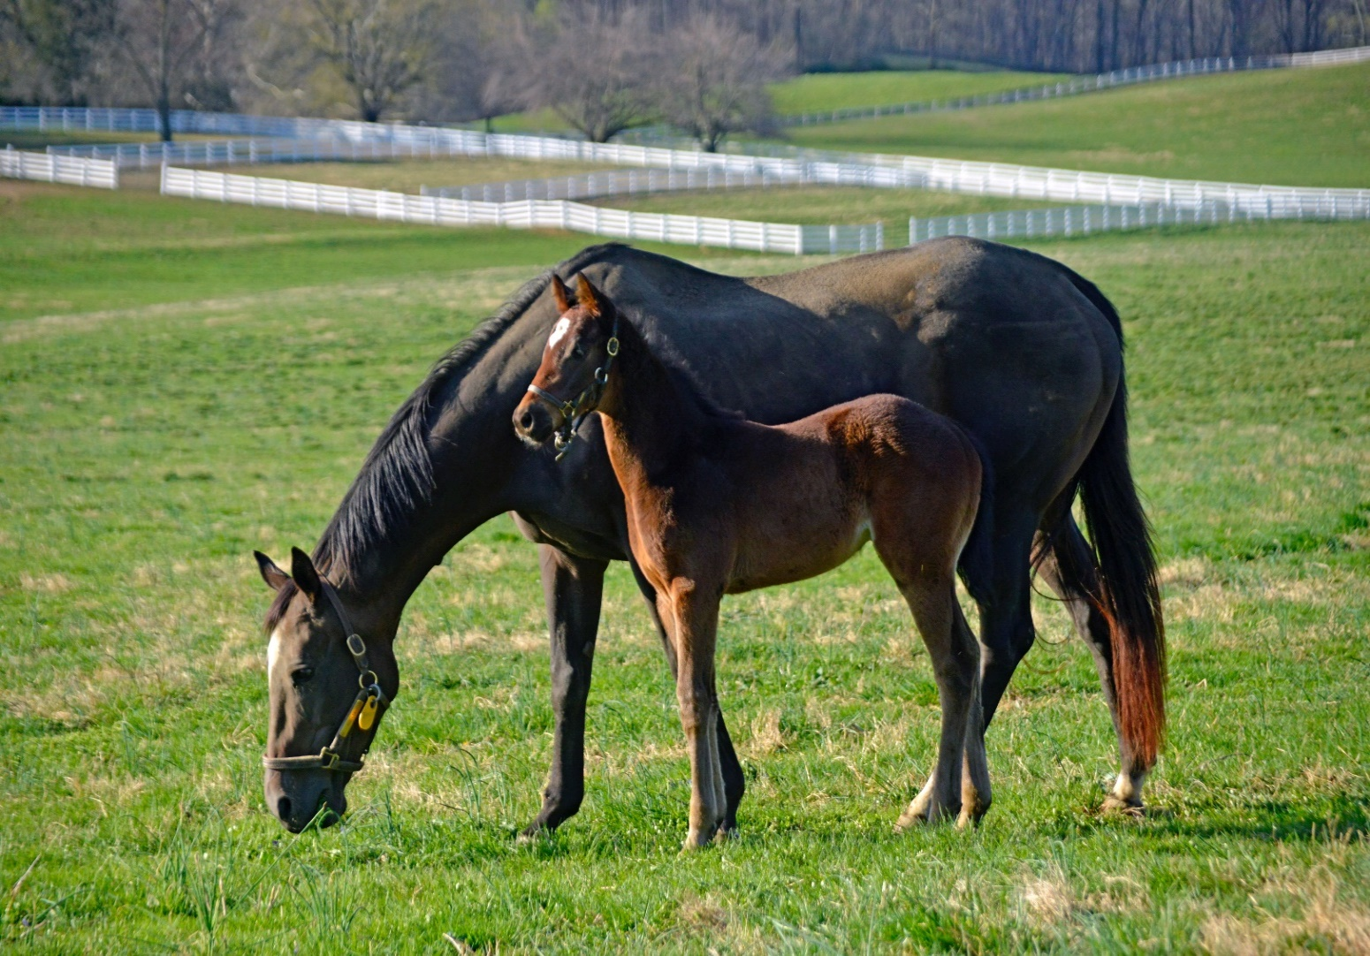
THOROUGHBRED BREEDING INDUSTRY
Declining number of mares and stallions nationwide, resulting in a dramatic fall in foal production
Shrinking on-track attendance
Loss of breeders and owners

Slide 6
Maryland’s Foal Crop
1991 - 2021
Nationwide, the numbers have continued to drop
Maryland has held its own compared to the nationwide average, in part due to support from the legislature and the breeding incentive program
Graph in 5-year increments
Source: 2023 Jockey Club Fact Book; Jockey Club Distribution of US Foal Crop by state: 1991, 1996, 2001

Slide 7
THOROUGHBRED BREEDING INDUSTRY
The Maryland horse breeding industry, while holding steady in recent years, is witnessing serious competitive challenges in the region — other states in the area are dedicating significantly more funds to reward the production of horses.
Legislature support has been key to maintaining the horse breeding industry.
Maryland-Bred horses make up a third of all horses racing in the state and are critically important to Maryland’s racing product now and in the future — a strong breeding program ensures a strong racing industry.
A strong breeding program also plays a critical role in Maryland’s agricultural and open space network.

Slide 8
THOROUGHBRED FARMS (1 of 2)
A day in the life of a Thoroughbred farm:
Every horse stall is cleaned every day with fresh hay and straw added.
Every horse is fed grain twice a day. This includes every holiday–there are no days off.
Every broodmare is examined by a veterinarian an average of twice before each breeding and twice after each breeding. Veterinarians are called for every injury, unusual swelling, or any other anomaly.
Every broodmare is bred an average of once or twice to conceive by a three-person team. One to hold the stallion, one to hold the broodmare, and one to wash both before and after each breeding.
Every horse is worked on by a blacksmith an average of eight times a year.

Slide 9
THOROUGHBRED FARMS (2 of 2)
A horse is a grazing animal and does best if it has an average of 1.5 acres to graze. This promotes large areas of open space.
The hay, straw, and grain are needed to support large open space on Maryland farms. Buying locally is generally more economical.
Maryland veterinarians and farriers need to be local since there is no time if there is an emergency.
Farm workers need to be local since many can’t afford their own housing and horse care is often around the clock.
All these jobs support the Maryland economy and open spaces.

Slide 10
What measures can be taken to stimulate the breeding industry in Maryland?

Slide 11
BRING BACK STABILITY TO THE THOROUGHBRED INDUSTRY
The industry needs a long-term agreement between the racetrack owners, the Maryland Horse Breeders Association, and the Maryland Thoroughbred Horsemen’s Association to bring stability to the industry.
This will give all investors confidence the industry will be around for many years.
It will benefit horse sales, horse breeders, horse owners, and the betting public.

Slide 12
DEVELOP ADDITIONAL REVENUE SOURCES (1 of 2)
Add Historical Horse Racing (HHR) machines at the racetracks. These machines use actual horse races from the past but change the names of the horses.
HHR machines are available in seven states, and are currently supplementing purses and state-bred funds in AR, KY, LA, and VA.

Slide 13
DEVELOP ADDITIONAL REVENUE SOURCES (2 of 2)
iGaming (any kind of online betting)
RaceTrax (uses horse racing for a keno-style game)
These ideas can then be converted into increased Breeder and Stallion Bonuses to Registered Maryland-Bred and/or Maryland-Sired horses to make the program competitive with those of surrounding states.

Slide 14
DEVELOP A MARYLAND-BRED RESTRICTED RACE PROGRAM
Restricted races are exclusive to horses meeting certain conditions–in this case, sired and/or foaled in Maryland.
All our neighboring states offer significant opportunities for their state-bred and state-sired horses.
Pennsylvania’s restricted race program is expansive– in 2022 the program was $8.2 million.

Slide 15
SUGGESTED INITIATIVES THAT WOULD RESULT IN POSITIVE EFFECTS
CREATE breeder and owner incentives that are competitive with surrounding states, including bonuses paid when there is no live racing in Maryland.
CREATE increased opportunities and significant financial incentives for Maryland-Bred and Maryland-Sired horses to breed and race in Maryland.
CREATE an economic environment conducive to maintaining farms for breeding and raising horses, thereby serving the state of Maryland by preserving open spaces and the integrity of the Chesapeake Bay.
CREATE jobs within the industry, as well as in related fields.

Slide 16
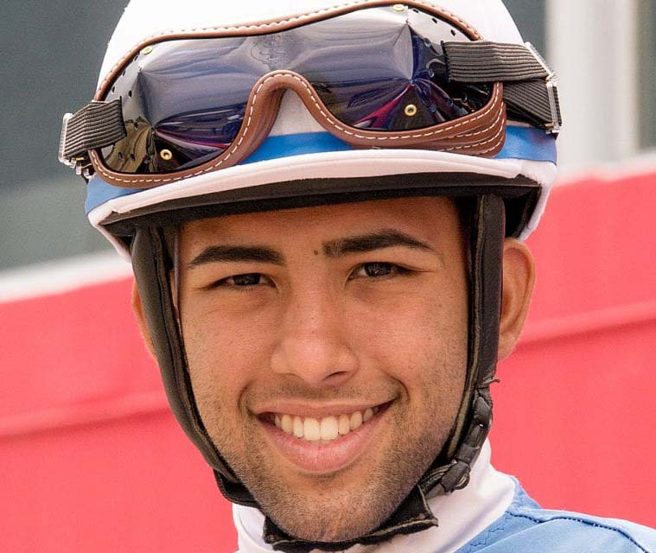
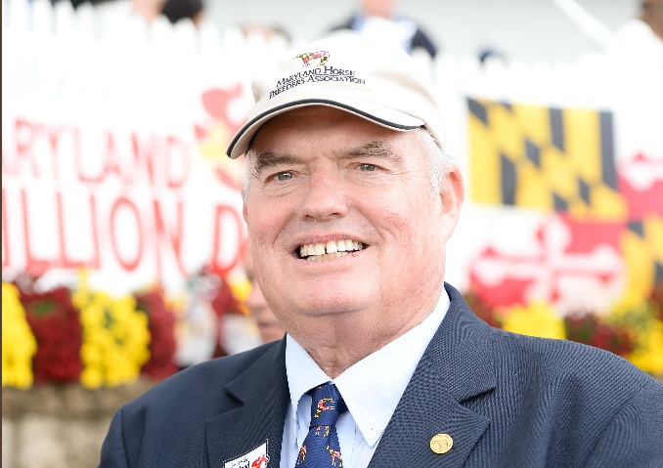
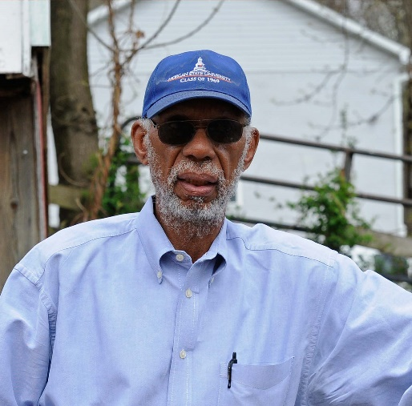
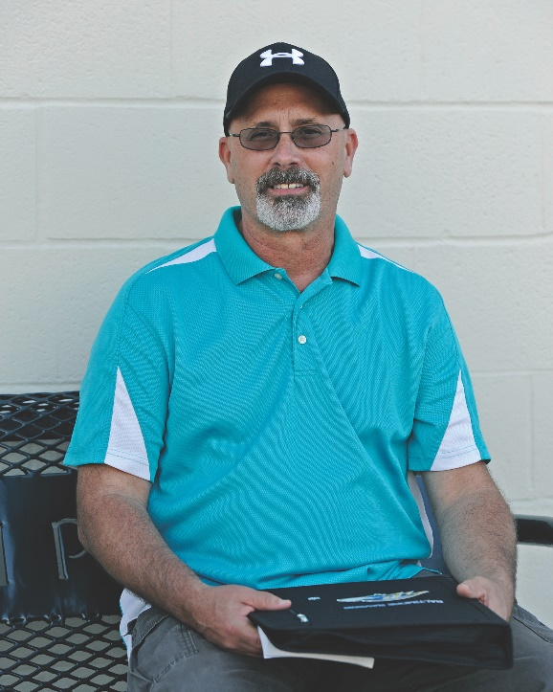
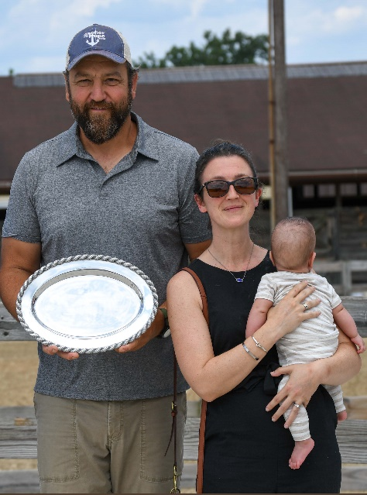
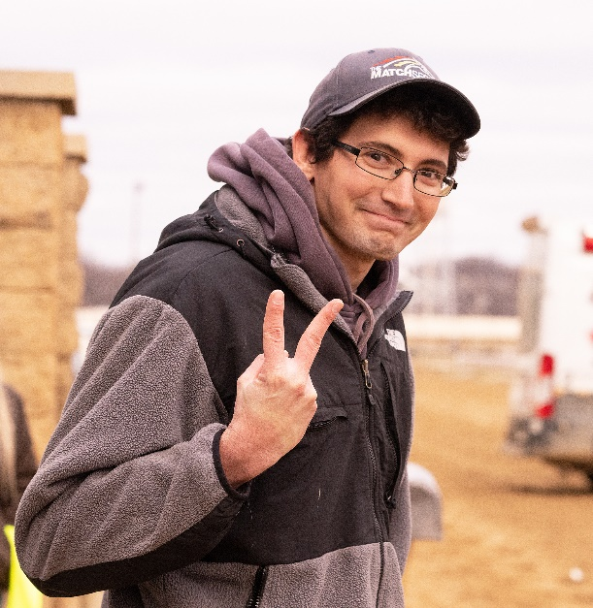
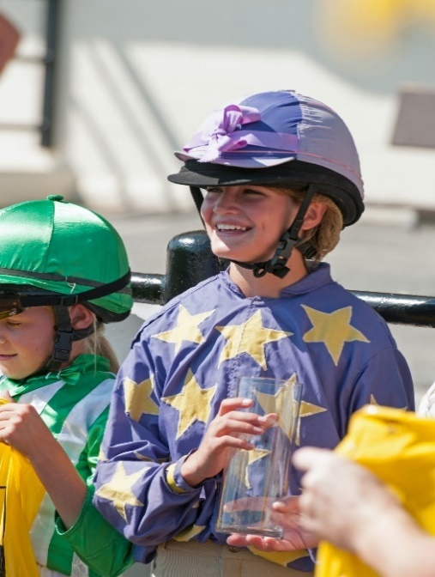
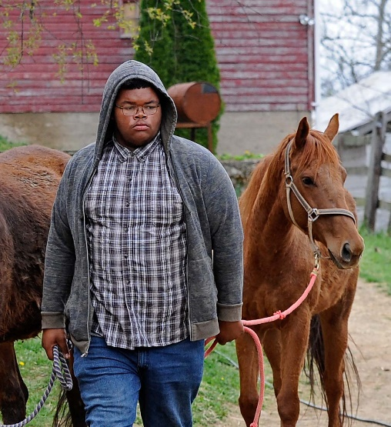
THE MANY FACES OF THE MARYLAND HORSE INDUSTRY

Slide 17
LINKS TO INFORMATIONAL RESOURCES
Maryland Horse Breeders Association & Affiliated Organizations
Marylandthoroughbred.com
Marylandmillion.com
Marylandhorse.com
Midatlantictb.com
Pennsylvania & Virginia Breed Associations
Pabred.com
Vabred.org
Virginiahorseracing.com
The Jockey Club – National Stud Book & Registry
Jockeyclub.com
Ownerview.com
Maryland Racing Commission
Dllr.state.md.us/racing
Possible Revenue Sources
Mdlottery.com/games/racetrax
Bettingusa.com/historical-horse-racing-machines
Sportsbettingdime.com/guides/legal/igaming

Slide 18
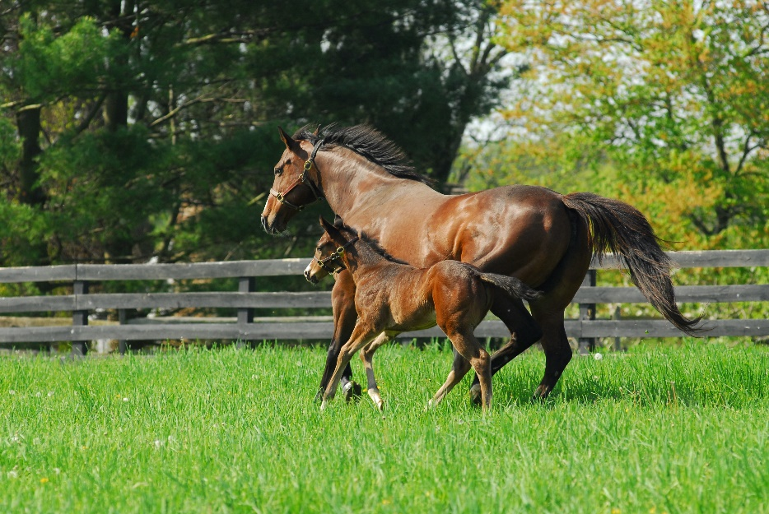
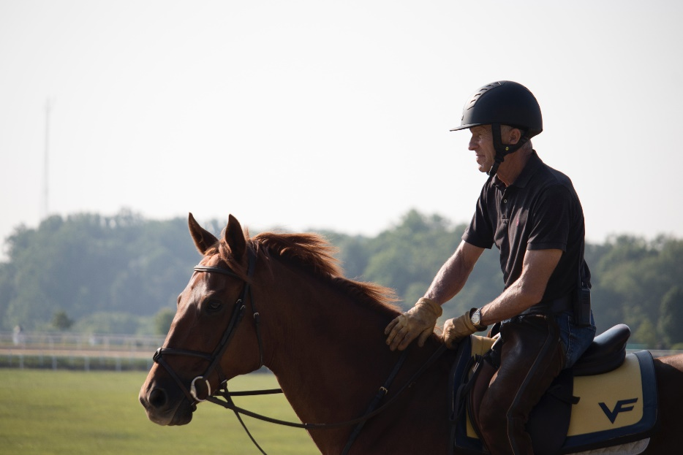
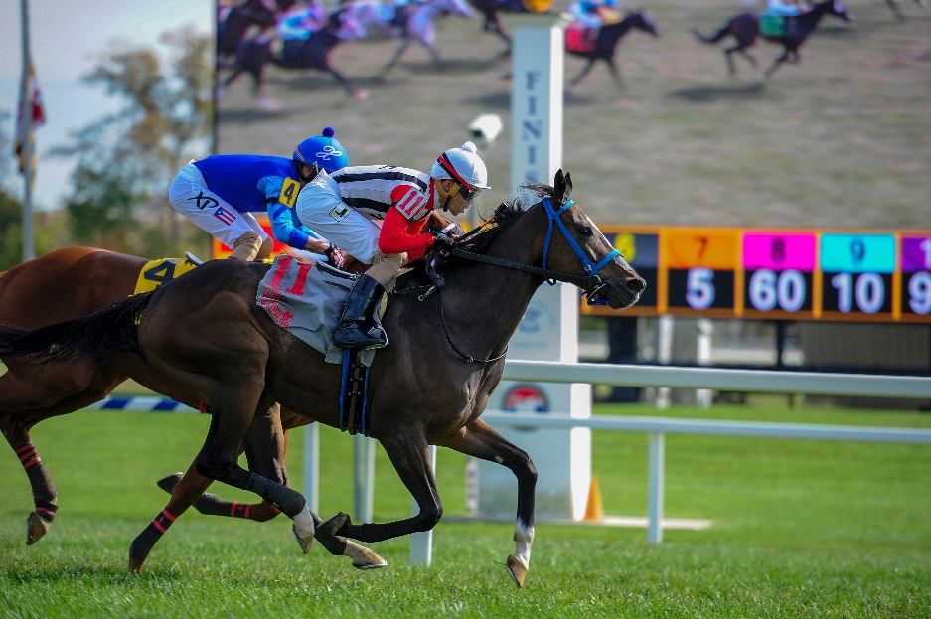
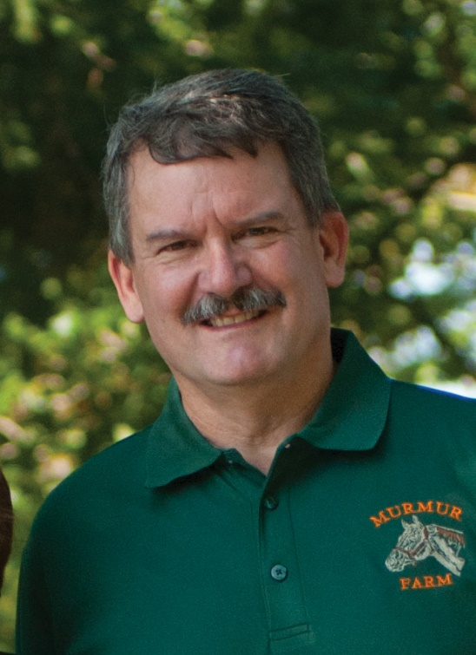
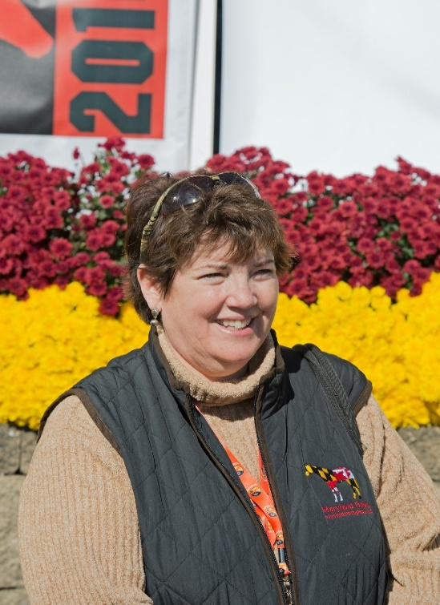
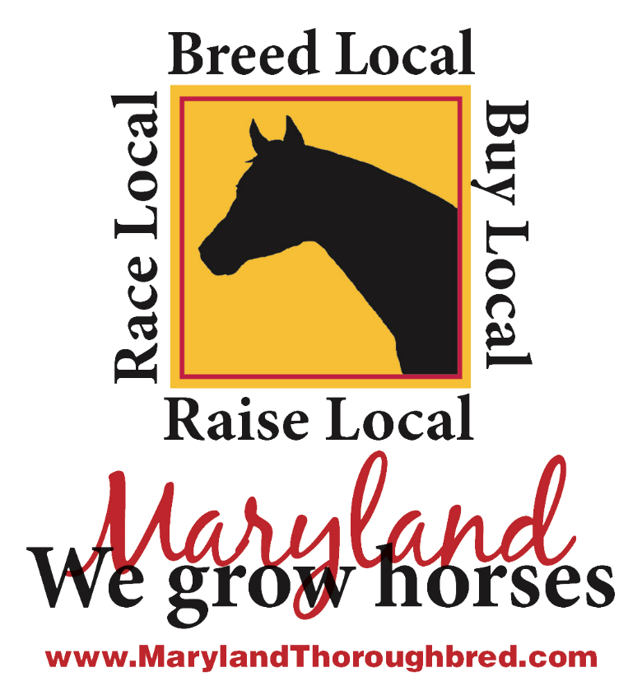
From foaling in Maryland…
To training in Maryland…
To racing in Maryland!
Maryland Horse Breeders Association
321 Main Street
Reisterstown, MD, 21136
(410) 252-2100 info@marylandthoroughbred.com
Kent Murray President
Cricket Goodall Executive Director

